Slide 1
B.TECH PROJECT REVIEW
SmartAttend
A Web-Based Student Attendance Management System
TEAM MEMBERS
A Siddhartha Varma – 2520090119
P Gowtham Varma – 2520090202
Gandi Karthikeya – 2520090103
Class / Section: [III Year B.Tech – Section]
Under the Guidance of
[Guide Name], [Designation]
[College / University Name] | Department of Computer Science

Slide 2
CONTENTS
What this review covers
1
Abstract
11
Implementation
2
Problem Statement
12
Experimental Setup
3
Motivation
13
Results
4
Objectives
14
Performance Evaluation
5
Literature Survey
15
Screenshots / Working Demo
6
Research Gap
16
Comparison with Existing System
7
Proposed Methodology
17
Challenges and Solutions
8
System Architecture
18
Future Work
9
Technologies Used
19
Conclusion
10
Dataset / Input Details
20
References
B.Tech Project Review | Dept. of Computer Science
1

Slide 3
A
OVERVIEW
Abstract
SmartAttend is a browser-based attendance register that replaces the paper roll call with a one-click digital workflow. A teacher opens a course, marks each student Present, Absent or Leave, and every percentage updates instantly. A companion student login lets each learner check themselves in, but only while the teacher has opened a live attendance session and only after entering that session's one-time code — with an optional GPS proximity check as a second layer. The system runs entirely in the browser using HTML, CSS and JavaScript, stores data locally, and requires no server, database installation or internet connection to operate.
B.Tech Project Review | Dept. of Computer Science
2

Slide 4
!
THE PROBLEM
Problem Statement
Manual attendance registers are slow to fill, error-prone to total, and give no visibility into a student's standing until it is too late. Totalling a month's attendance by hand is tedious and mistakes go unnoticed until exam eligibility is at risk. Existing digital alternatives that allow self check-in are often vulnerable to proxy attendance, since a student can mark themselves present from anywhere without any verification that they are actually in the classroom. There is a need for a lightweight system that is fast to use, calculates standing in real time, and makes remote or proxy marking difficult without requiring heavy infrastructure.
B.Tech Project Review | Dept. of Computer Science
3

Slide 5
★
WHY THIS PROJECT
Motivation
Attendance tracking is one of the most repetitive tasks in a classroom, yet it directly affects a student's academic standing. A system that removes manual totalling, flags low attendance immediately, and still lets students participate in marking their own presence — without opening the door to proxy attendance — saves teacher time and gives students earlier, clearer warnings. Building it as a plain front-end project also made it a practical vehicle for applying core web-development concepts: state management, authentication flows, the Geolocation API, and accessible, responsive interface design, all without needing a server to deploy or maintain.
B.Tech Project Review | Dept. of Computer Science
4

Slide 6
✓
GOALS
Objectives
Let a teacher mark a class in one click per student, with live percentage calculation
Allow students to self-check-in, gated by a teacher-issued session and a one-time code
Add an optional location check so self check-in can be restricted to the classroom
Flag students below a configurable attendance threshold automatically
Provide reports: a per-student report card, CSV export and a printable register
Keep the whole system framework-free, offline-capable and easy to run from VS Code
B.Tech Project Review | Dept. of Computer Science
5

Slide 7
L
PRIOR WORK
Literature Survey
Attendance-automation approaches generally fall into three families. RFID and biometric kiosks give strong proof of presence but need dedicated hardware per room. QR-code and app-based check-ins are cheap to deploy but are commonly reported to be vulnerable to a student sharing the code with an absent classmate. Server-backed web portals (built on frameworks such as Django or Node.js with a relational database) offer the most control and audit capability but require ongoing hosting and database administration that is often out of reach for a small classroom project. SmartAttend sits deliberately in the third category's spirit — structured records, roles and an audit trail — while keeping the first deployment lean enough to run as static files, closer to the second category's simplicity.
B.Tech Project Review | Dept. of Computer Science
6

Slide 8
?
WHAT'S MISSING
Research Gap
Lightweight, framework-free attendance tools rarely combine self check-in with any proof of presence at all — most simply trust the click. Where a proximity or code check does exist, it is usually bundled into a heavier commercial platform that needs a backend, an app install and recurring cost. There is a gap for a small, inspectable, zero-install project that still layers in a genuine presence check — a teacher-issued session code plus an optional geofence — while remaining simple enough for a single teacher to run from a laptop with no IT support.
B.Tech Project Review | Dept. of Computer Science
7

Slide 9
M
APPROACH
Proposed Methodology
The system is built as a single-page application in plain HTML, CSS and JavaScript. All records — students, courses, attendance marks and session state — live in one JavaScript object that is persisted to the browser's localStorage after every change, so data survives a refresh without any server round-trip. Two role-based views render from the same data: a teacher register for marking and reporting, and a student dashboard limited to that student's own records and today's check-in.
Teacher opens a course & starts a session
1
2
A 6-digit code is generated, shown in class
3
Student logs in & enters the code
4
Optional: device location is checked
5
Attendance is saved to localStorage instantly
B.Tech Project Review | Dept. of Computer Science
8

Slide 10
⬚
STRUCTURE
System Architecture
1
2
3
Presentation layer
Application logic
Data layer
index.html + style.css
Login screen, teacher register,
student dashboard, report-card and
settings dialogs
→
script.js
Authentication, session codes,
Haversine distance check,
percentage & report calculations
→
Browser localStorage
Students, courses, attendance
marks, sessions and security
settings as one JSON object
All three layers run inside one browser tab — there is no network call and no backend process.
B.Tech Project Review | Dept. of Computer Science
9

Slide 11
⚙
TECH STACK
Technologies Used
1
2
3
HTML5
CSS3
JavaScript (ES6+)
Semantic page structure, forms, the <dialog> element
Custom properties, flexbox, grid, print styles, dark mode
App logic: state, rendering, event handling
4
5
6
Web Storage API
Geolocation API
Haversine formula
localStorage persistence across sessions
Browser location permission + coordinates
Great-circle distance for the campus radius check
B.Tech Project Review | Dept. of Computer Science
10

Slide 12
D
DATA
Dataset / Input Details
Students — roll number, name, password (demo: roll number in lowercase)
Courses — code, name, and the weekdays each course meets
Attendance marks — one P / A / L value per student, per course, per date
Sessions — a course's live 6-digit code and its expiry time
Security settings — whether location is required, saved campus coordinates, radius
Demo seed data — 10 students and 3 courses across the past 75 days, for testing
B.Tech Project Review | Dept. of Computer Science
11

Slide 13
{ }
BUILD
Implementation
Authentication — separate student and staff login forms, role stored in session
Teacher register — course tabs, monthly grid, click-to-cycle Present/Absent/Leave
Student self check-in — session code form, inline location-check messaging
Reporting — live percentage bars, low-attendance alerts, per-student report card
Utilities — CSV export, printable view, JSON backup and restore
Three files — index.html, style.css, script.js — no build step, no dependencies
B.Tech Project Review | Dept. of Computer Science
12

Slide 14
⚗
TEST SETUP
Experimental Setup
The application was run locally through Visual Studio Code's Live Server extension, which serves the three files over http://127.0.0.1 — the Geolocation API's default secure-context requirement is satisfied for localhost, so the location check could be tested without deploying to a real host. Functional behaviour was verified by scripting the page's logic against a stand-in DOM in Node.js and exercising each flow directly: correct and incorrect logins, a wrong or expired session code, a correct code, and the distance check with simulated coordinates both inside and outside the allowed radius.
B.Tech Project Review | Dept. of Computer Science
13

Slide 15
R
OUTCOME
Results
3
10
3
2
course tabs, each with its own weekly schedule
demo students across 75 days of seed data
attendance states: Present, Absent, Leave
layers guarding self check-in: code + geofence
All core flows verified end to end: teacher marking, live percentage updates, low-attendance alerts, student self check-in with a correct and an incorrect code, the location check at both ranges, CSV export, and backup / restore.
B.Tech Project Review | Dept. of Computer Science
14

Slide 16
⚡
EVALUATION
Performance Evaluation
Marking a student updates that row's percentage and the course summary on the same click — no page reload, no network wait
Every write is saved to localStorage immediately, so a refresh or an accidental tab close loses nothing
The register, reports and report card all re-derive from the same in-memory data, so figures never disagree with each other
Tested with the full demo dataset (10 students × 3 courses × 75 days) without any visible lag while marking or searching
B.Tech Project Review | Dept. of Computer Science
15

Slide 17
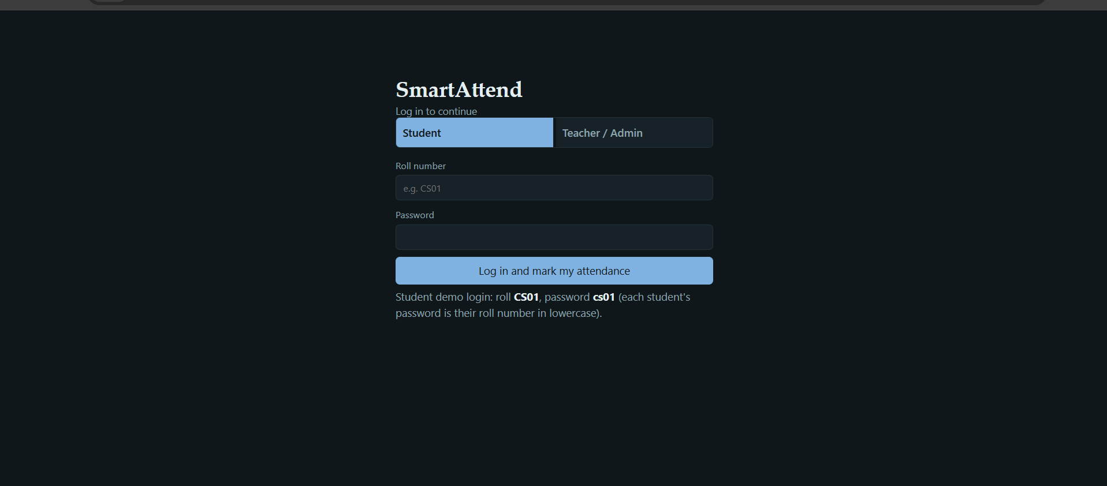
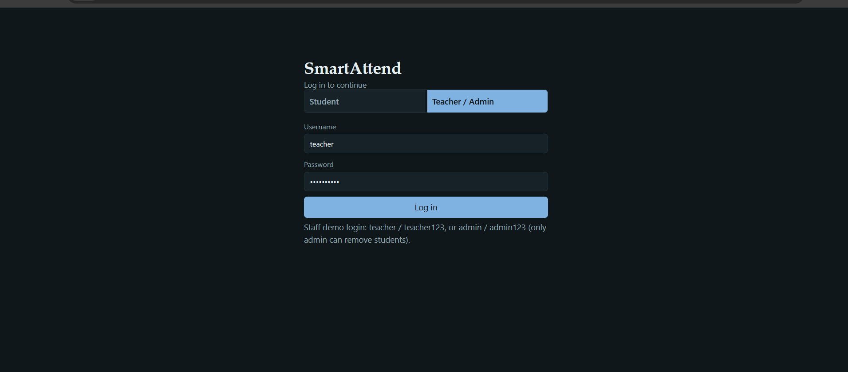
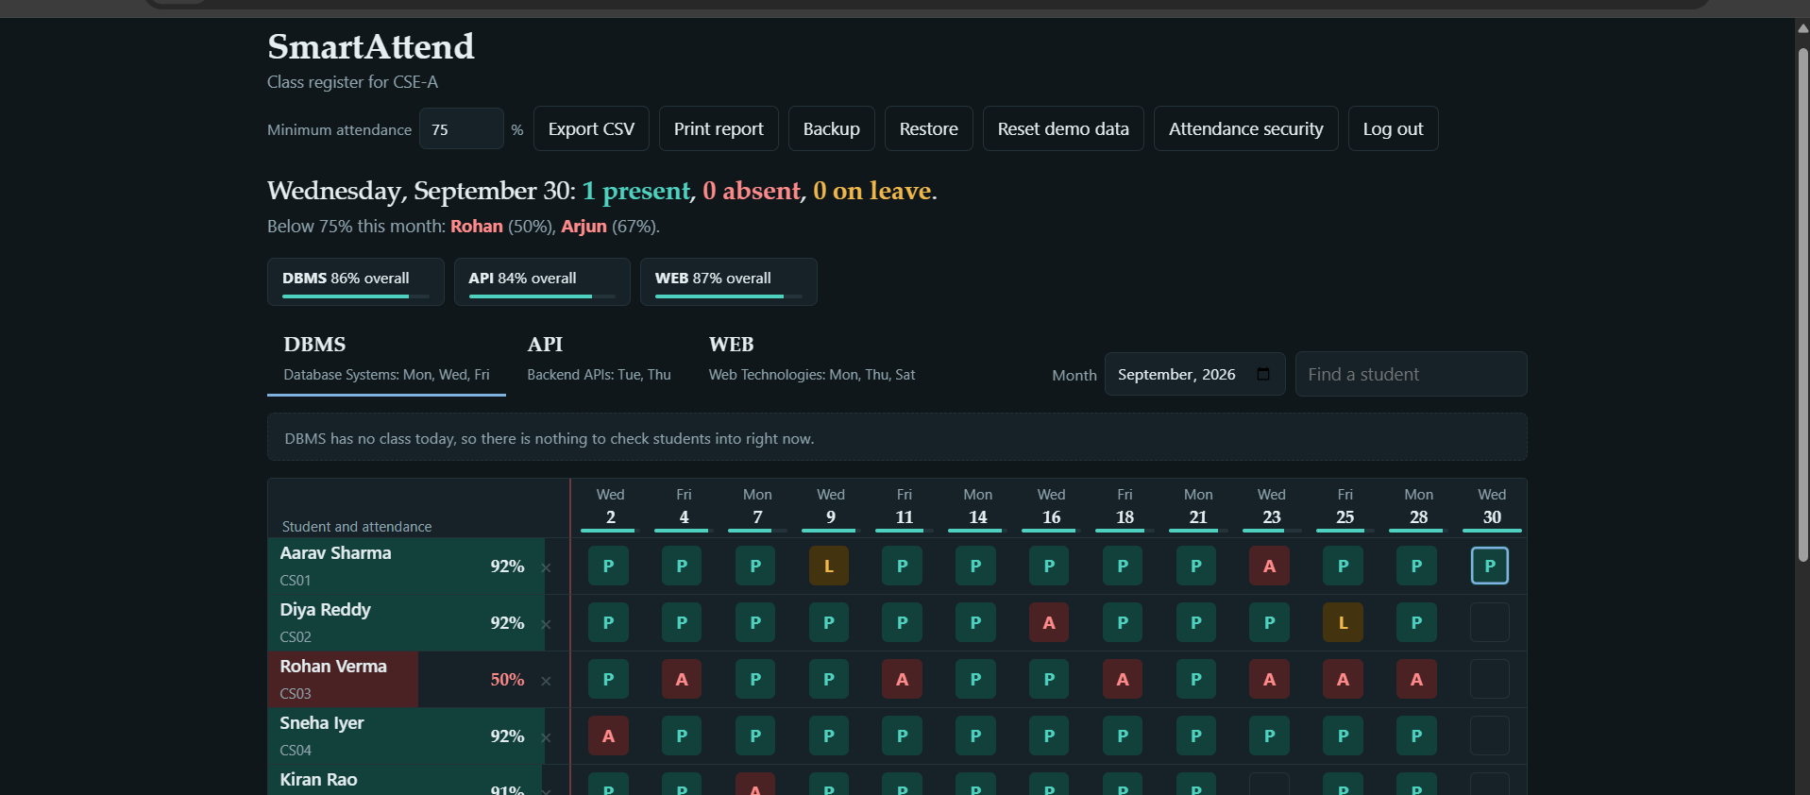
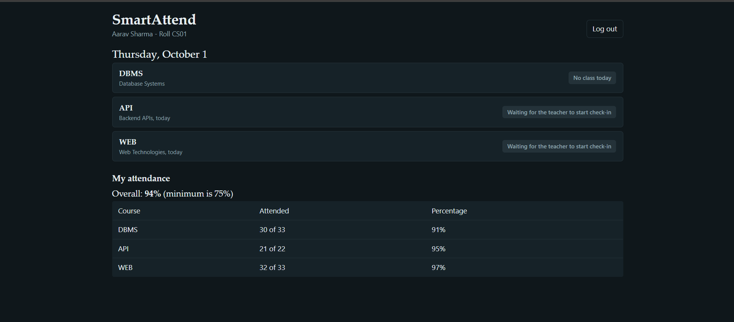
▣
DEMO
Screenshots / Working Demo
16

Slide 18
⇄
COMPARISON
Comparison with Existing Systems
Aspect
Paper register
Simple self-check-in app
SmartAttend
Totalling attendance
Manual, slow
Automatic
Automatic, instant
Proxy / remote marking
Possible (buddy marking)
Easy — no verification
Needs the live code (+ optional GPS)
Setup required
None
Server + install
Open one HTML file
Low-attendance warning
None
Rare
Shown live, per student
B.Tech Project Review | Dept. of Computer Science
17

Slide 19
⚒
PROBLEM SOLVING
Challenges and Solutions
Challenge
Solution
Students could self-mark from outside class
→
A teacher-issued session with a 10-minute code, plus an optional GPS radius check
Challenge
Solution
Data would be lost on a page refresh
→
Every change writes to localStorage immediately, so state survives reloads
Challenge
Solution
Mixing up who marked a box — teacher or student
→
Self-marked cells get a visible outline so the teacher can see what a student checked in
Challenge
Solution
No shared device between teacher and students
→
Noted as a known limitation; the roadmap item is a small backend for true multi-device sync
B.Tech Project Review | Dept. of Computer Science
18

Slide 20
➜
WHAT'S NEXT
Future Work
Move storage to a small backend (FastAPI + SQLite) so attendance syncs across devices
Verify the session code and location server-side, closing the client-only spoofing gap
Add SMS or email alerts to students and parents when attendance falls below the limit
Package the student view as an installable mobile web app for faster daily check-in
Add charts for attendance trends over the term, alongside the existing CSV export
B.Tech Project Review | Dept. of Computer Science
19

Slide 21
✔
SUMMING UP
Conclusion
SmartAttend shows that a meaningful, well-guarded attendance system does not require a server or a framework. Built entirely in HTML, CSS and JavaScript, it gives teachers a fast marking register with live percentages and automatic low-attendance alerts, while giving students a self check-in path that stays honest through a teacher-issued session code and an optional location check. The result is a project that is simple to run — open one file in VS Code with Live Server — while still demonstrating real engineering judgement: state management, role-based access, browser APIs, and an explicit, honest discussion of its own security limits.
B.Tech Project Review | Dept. of Computer Science
20

Slide 22
§
SOURCES
References
1.
MDN Web Docs — Web Storage API (localStorage), Mozilla Foundation, 2024.
2.
MDN Web Docs — Geolocation API, Mozilla Foundation, 2024.
3.
W3C — HTML Living Standard, WHATWG, 2024.
4.
W3C — CSS Custom Properties for Cascading Variables, 2023.
5.
MDN Web Docs — Haversine-style great-circle distance calculations, 2023.
6.
Visual Studio Code Documentation — Live Server extension usage, Microsoft, 2024.
B.Tech Project Review | Dept. of Computer Science
21

